Slide 1

Natural Cycles
Assignment for Senior Data Scientist position
-
Jeroen Buil

Slide 2
Contents
Introduction
Exploratory Data Analysis
Questions:
What is the chance of getting pregnant within 13 cycles?
How long does it usually take to get pregnant?
What factors impact the time it takes to get pregnant?
ML vs non-ML methods approach?

Slide 3

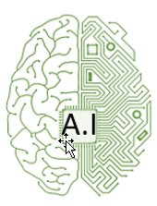










Quick introduction
Jeroen Buil
Senior Data Scientist / Biomedical Engineer
Focus:
Practically applying AI for
Data Collection
Models
Insights
2013
2024

Slide 4

EDA: Exploratory Data Analysis
=> First step before any analysis
Q: Is the data suitable?

Slide 5
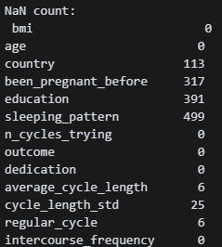
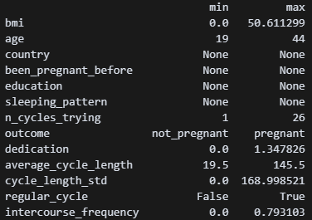
EDA: Quick glance
Missing data:
~40% of samples miss some data points
=> Need to remove (or ideally fill) depending on analysis
Data range:
BMI of 0 => not possible
Big spread in (average) cycle length
Dedication +100% => not possible

Slide 6
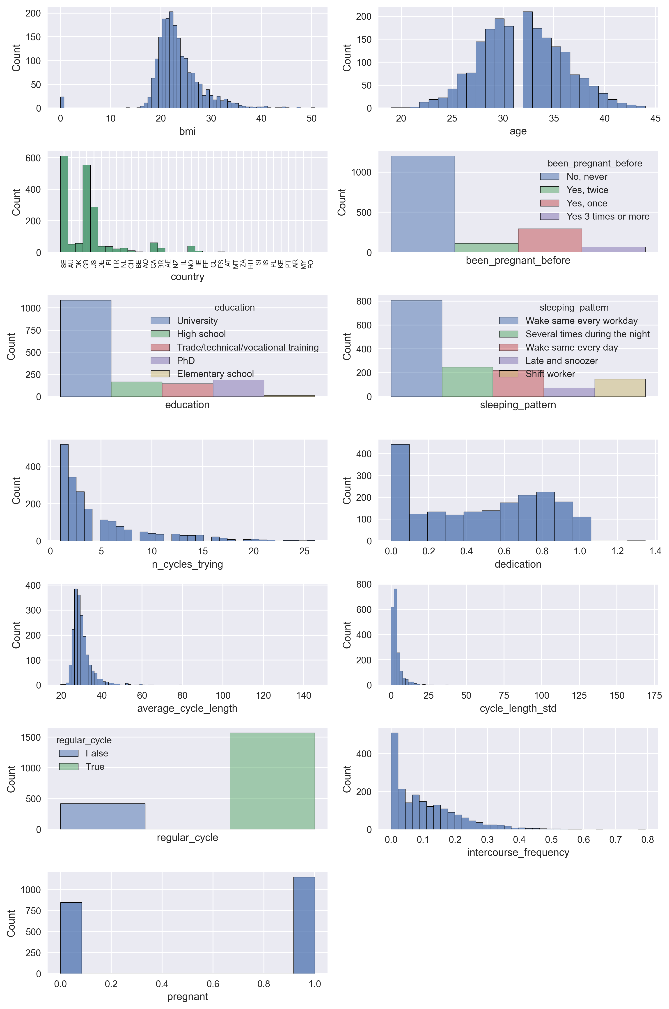
EDA: Histograms
BMI:
Contains missing data (BMI of 0) => remove!
Underweight (BMI <16) + Morbidly Obese (BMI > 40) present => Keep or consider outliers?
Cycle length:
(Very) high cycle lengths (>35 - 145 days) => users with PCOS*? => Keep or consider outliers?
Unbalanced variables:
Country
Been pregnant before
Education
Sleeping Pattern
Cycle regularity
Regular_cycle
=> Makes them harder to use as predictors!
*Polycystic ovary syndrome (PCOS) is characterised by irregular menstrual cycles, higher chance of diabetis type II and difficulty getting pregnant - https://en.wikipedia.org/wiki/Polycystic_ovary_syndrome

Slide 7
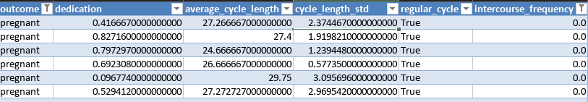

EDA: Data Inconsistencies?
No intercourse, but still pregnant?
=> remove samples
cycles_length > 50 days are NOT regular cycles!
=> Regularity of cycle is determined by cycle_length_std (< 5 days)

Slide 8
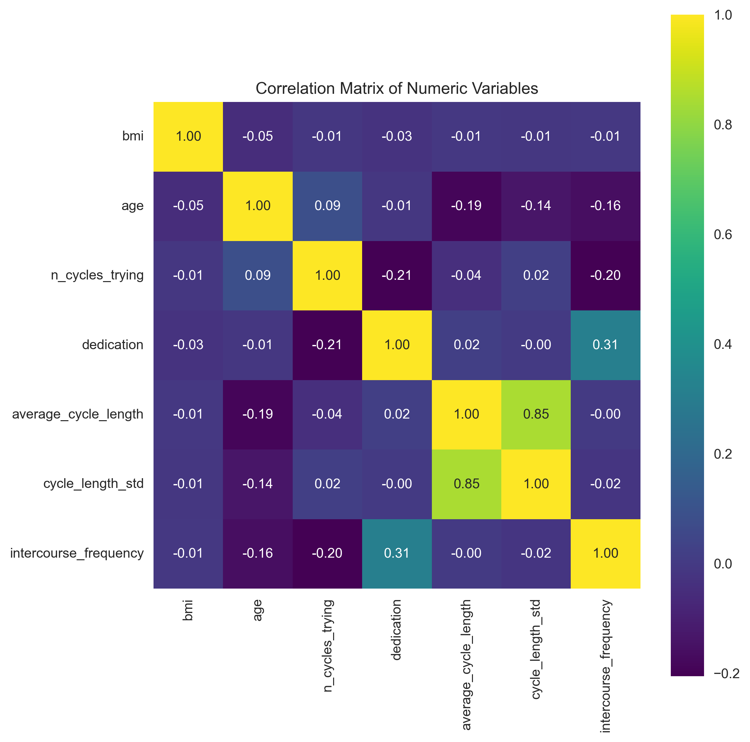
EDA: Data correlation
High correlation:
Average cycle length <=> Cycle length std
This is to be expected
=> consider keeping only one of the two

Slide 9
EDA: Conclusion
Data seems usable!
Data requires some clean-up
Not all samples + variable are useable for modelling

Slide 10
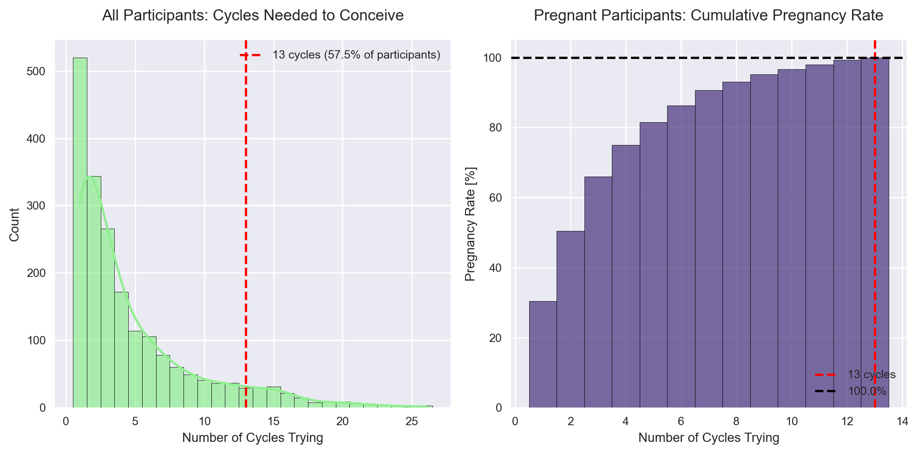
Q1: What is the chance of getting pregnant within 13 cycles?
Group: | Chance | Participants
Got pregnant within the study | 57.5% | 1148 / 1995participants
Got pregnant within the study within 13 cycles | 57.5% | 1148 / 1995 participants
Got pregnant within 13 cycles out of all pregnant participants | 100% | 1148 / 1148 pregnant participants

Slide 11
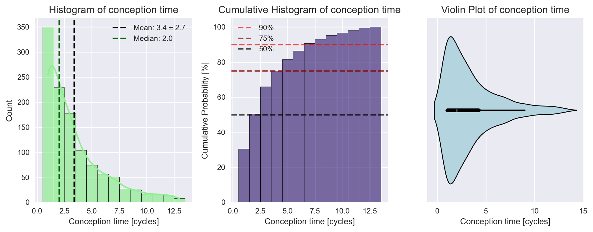
Q2: How long does it usually take to get pregnant?
Answer:
Majority of participants (>50%) got pregnant ≤ 2 cycles
90% did so ≤ 7 cycles
What is “usually”? => 50%? 90%?
Answer expressed in Days/Cycles?
Note: only pregnant participants are included

Slide 12
Q2: How long does it usually take to get pregnant?
Additional remarks:
Not all participants got pregnant during the study
Only 1139/1975 participants (57,8%)
Longer study time might show longer ‘average’ conceptions times

Slide 13

Q3: What factors impact the time it takes to get pregnant?
Two approaches:
Non-ML
ML:
Why?
(Relatively) Low amount of variables
Many categorical variables are unbalanced, can cause bias
Simpler method => easier interpretable results

Slide 14
First more data cleaning needed
Removed “outliers” | Why
Non-pregnant participants | We want to know how quickly, not IF they got pregnant.
Pregnant participants with intercourse frequency 0 | Can’t get pregnant without sexual intercourse.
BMI < 12 | Unrealistic value
Dedication > 1.00 | You can’t log more than 100% of days
Remove samples with NaN’s / empty values | We want to investigate all parameters
Clean samples: 1121 (out of 1995)

Slide 15
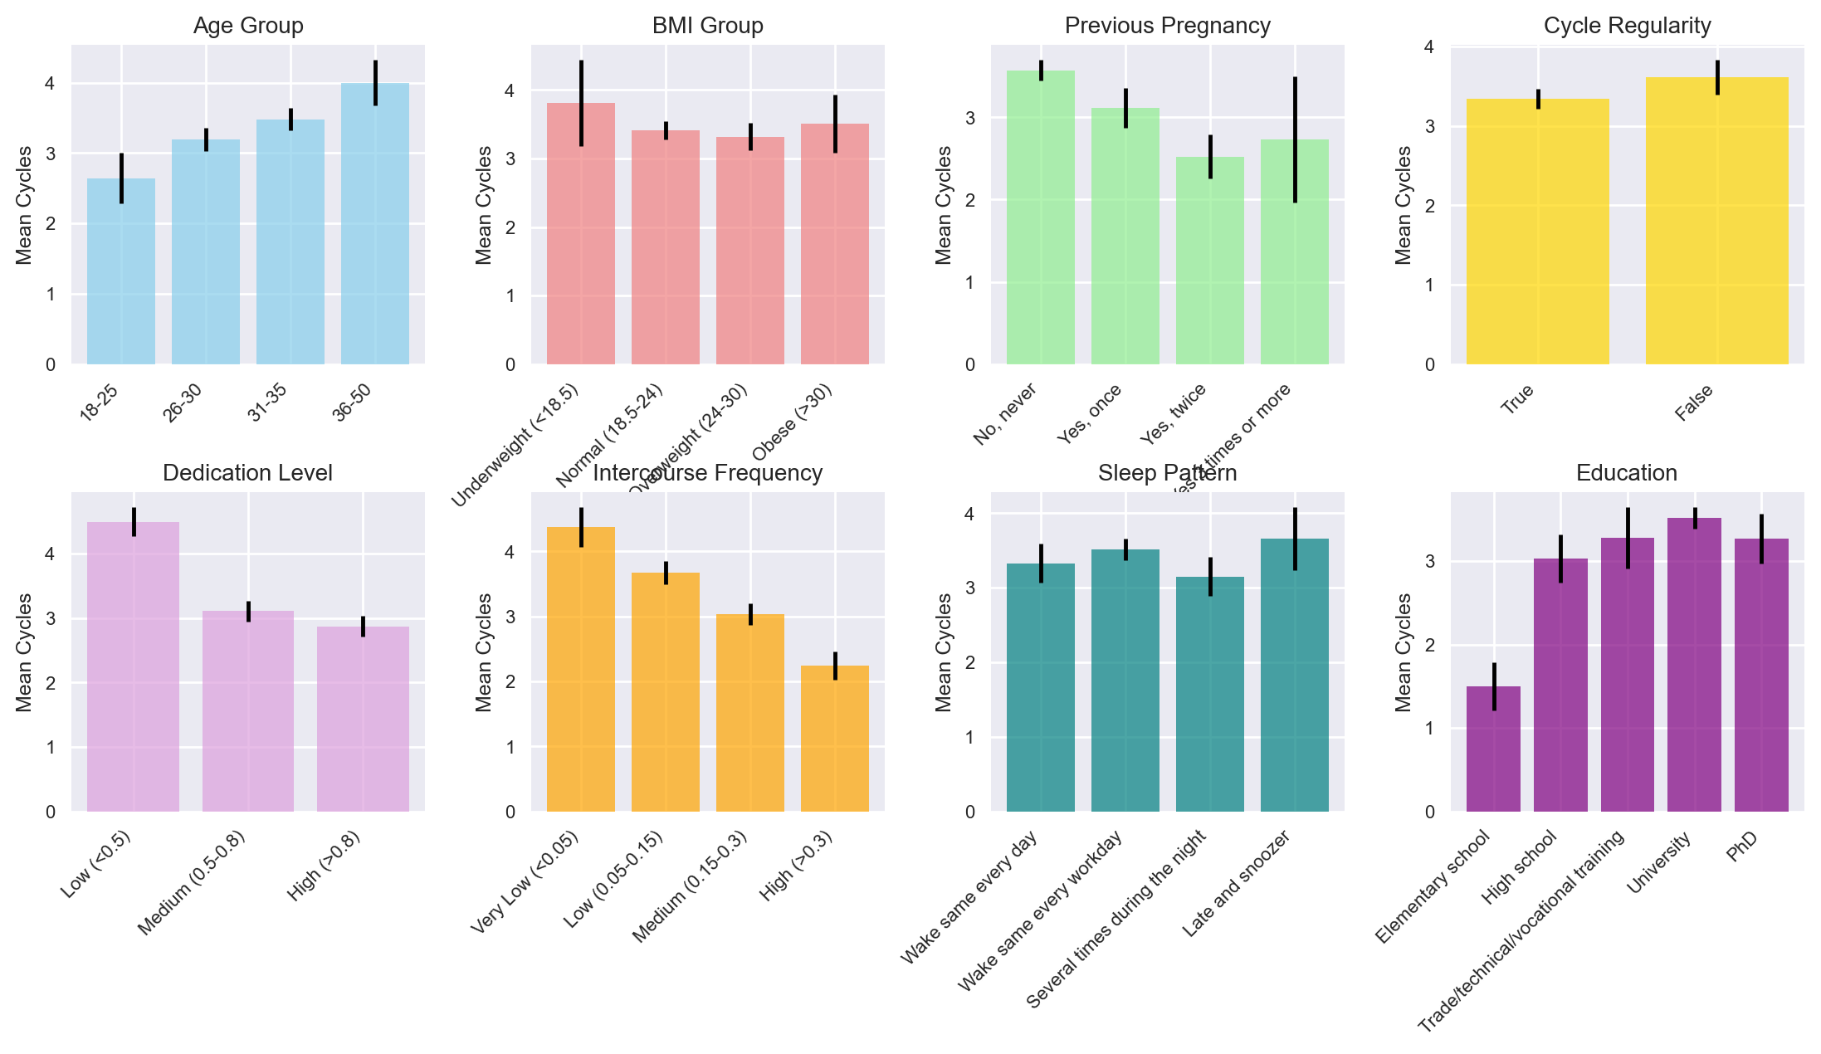
Simple binning in groups already shows obvious effects

Slide 16
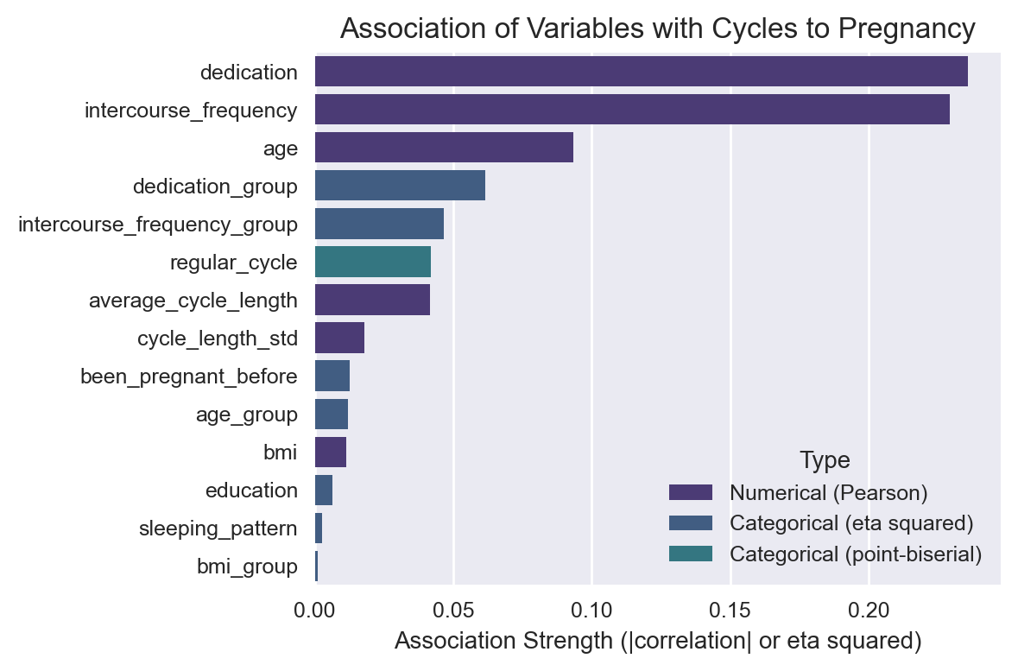
Statistical analysis confirms (linear) effect
All 3 seem quite logical:
Dedication
Better tracking => quicker pregnant
Intercourse frequency
Regular intercourse => quicker pregnant
Age
Younger => more fertile => quicker pregnant

Slide 17
Also non-linear effects visible Limitation of linear analysis => More advanced modelling needed?

Slide 18

Q4: How would your approach change if you were to use different techniques (e.g., ML or non-ML methods)?
Two approaches:
Non-ML
ML:
Why?
Easier to to investigate complex (non-linear) patterns
Resulting model (potentially) useable for predicting conception time

Slide 19

Model choice
When in doubt: XGBoost!
Easy implementation (especially compared to neural networks)
Accepts categorical + numerical data
Allows for classification + regression modeling
Build-in explainability tools (feature importance)
Note: average performance over 5-fold cross validation is shown

Slide 20
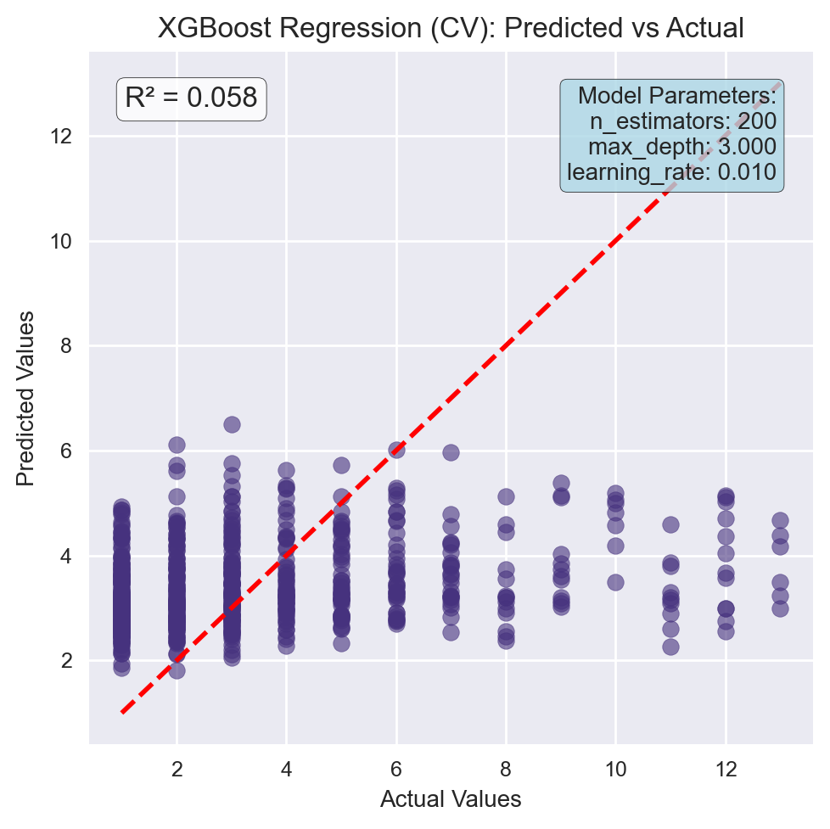
Poor performance XGBoost regression model...
Likely due to data imbalance
Majority of conceptions within 3 cycles...

Slide 21
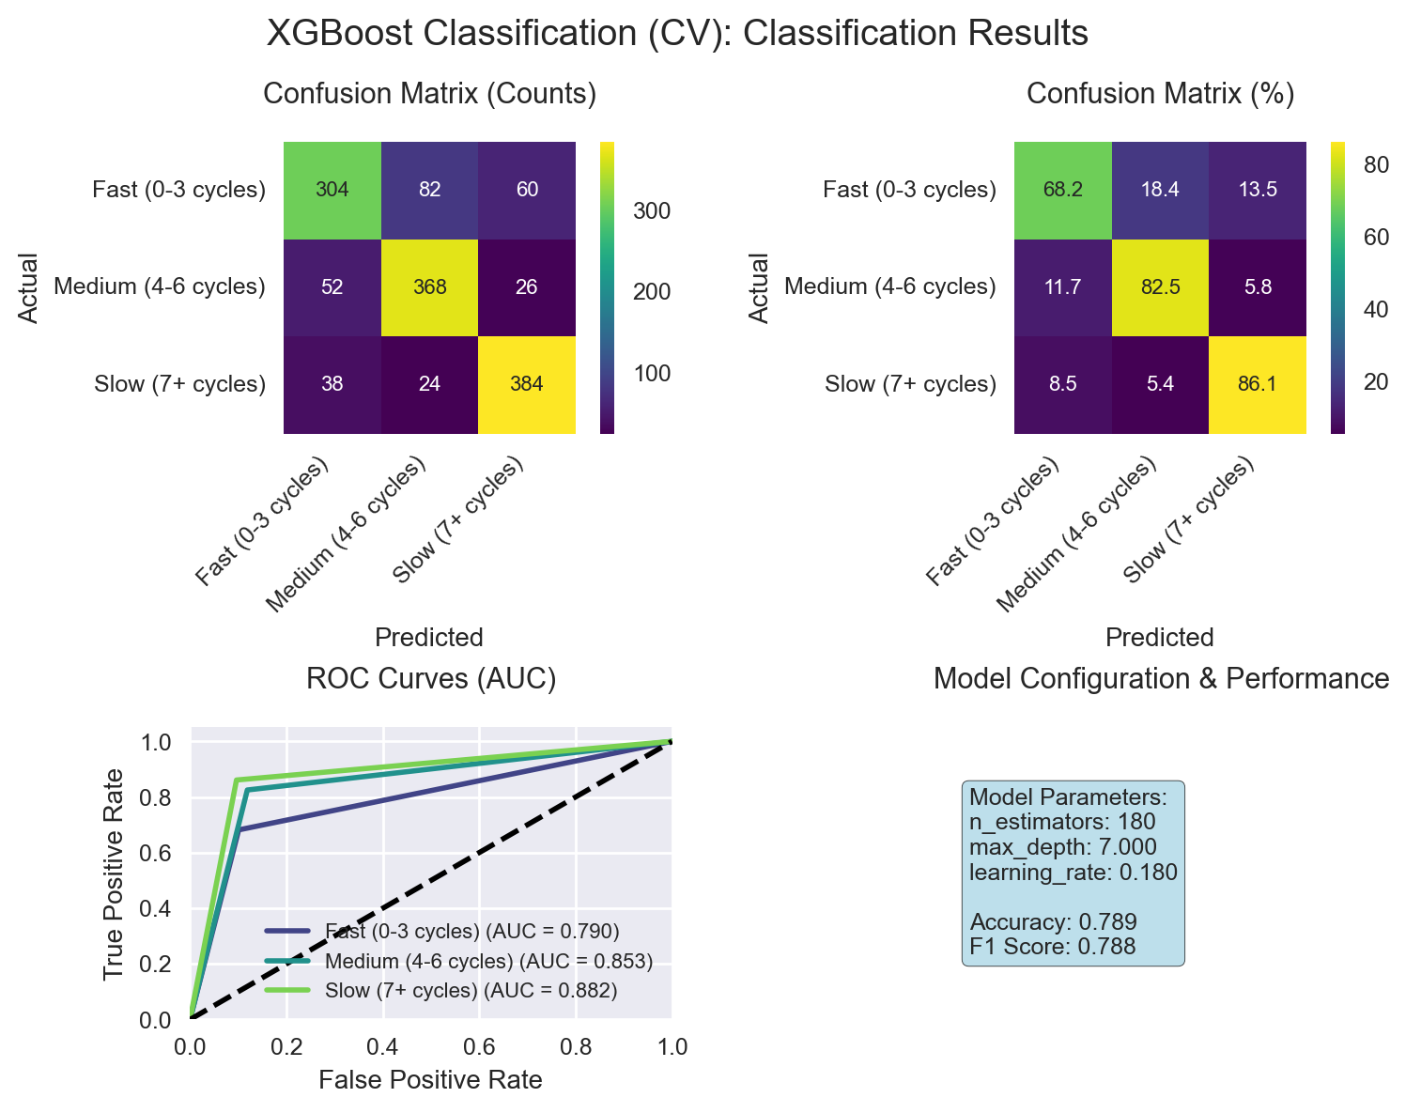
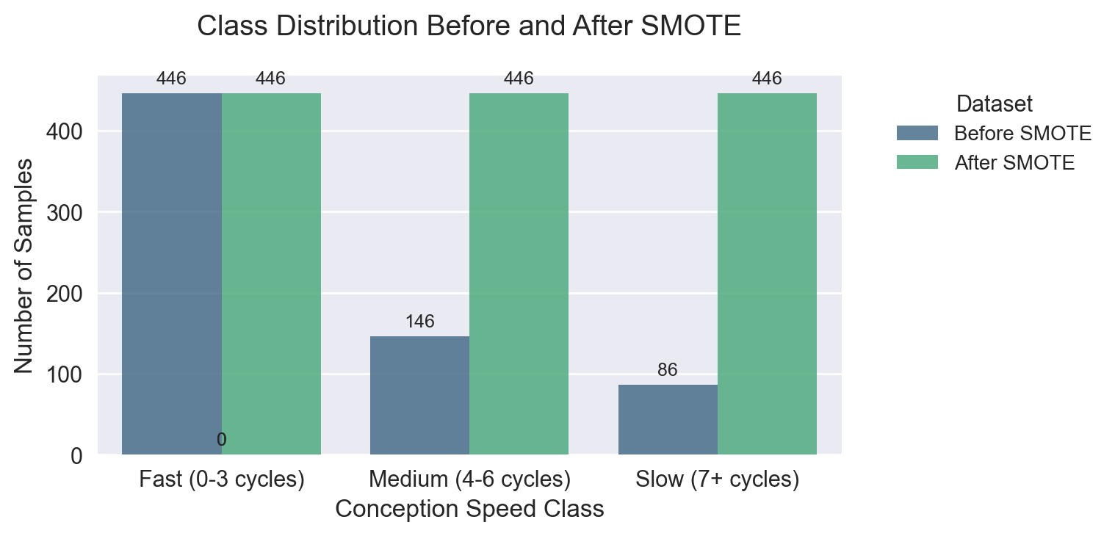
Solution: bin, balance and classify!
Group conception times into 3 bins
Rebalance classes
Classification now gives ~79% accuracy

Slide 22
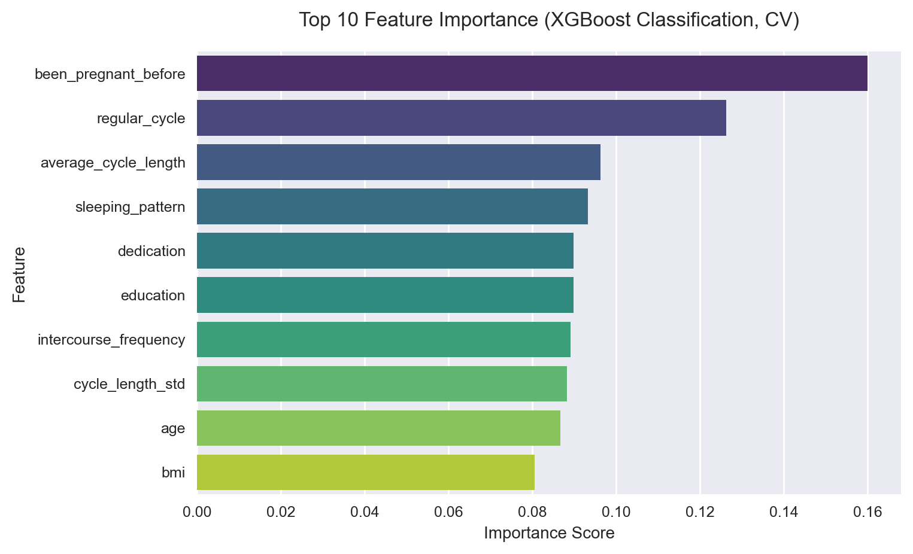
Feature importance shows new effects affecting conception time

Slide 23
Conclusion
ML techniques require (more) tweaking to get working
But can reveal more influencing factors
Factors affecting conception time (in order of importance):
Nr of previous pregnancies
Cycle regularity and average length
Sleeping patterns
Dedication to logging data on Natural Cycles
Intercourse frequency
Physical condition: Age + BMI
(Further investigation needed HOW these affect conception time)

